Slide 1
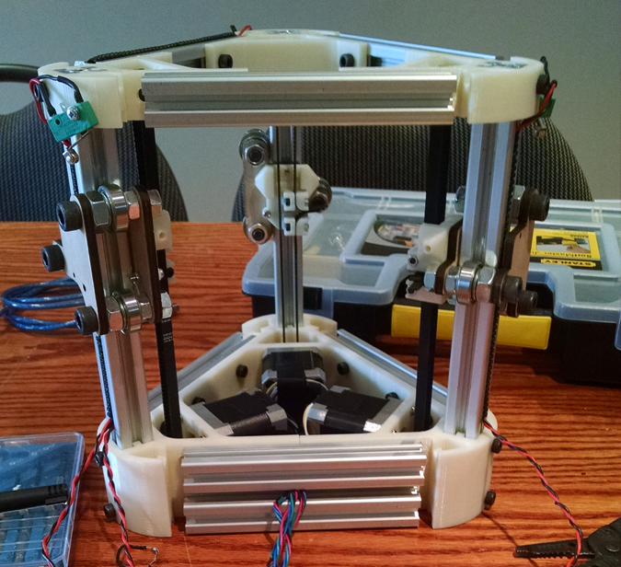
Delta Laser
Dave Mariano and Jordan Humphries

Slide 2

The Mini-Kossel Delta 3D Printer

Slide 3
Backend and Algorithms Roadmap
January:
● Project Proposal
● Print/Cut and Order Parts
● Begin Software Research and Development
● Assemble
February:
● Finish Assembly
● Troubleshoot RAMPS and Arduino
● Troubleshoot RAMPS with new Arduino
● Continue Research and Development
March:
● Develop Python Script and Load on Raspberry Pi
● Test Input into Pololu Drivers
● Test New RAMPS with Working Arduino
● Test Server with Delta Robot
● Install Required Software on Raspberry Pi
● Test Server and App via Raspberry Pi

Slide 4
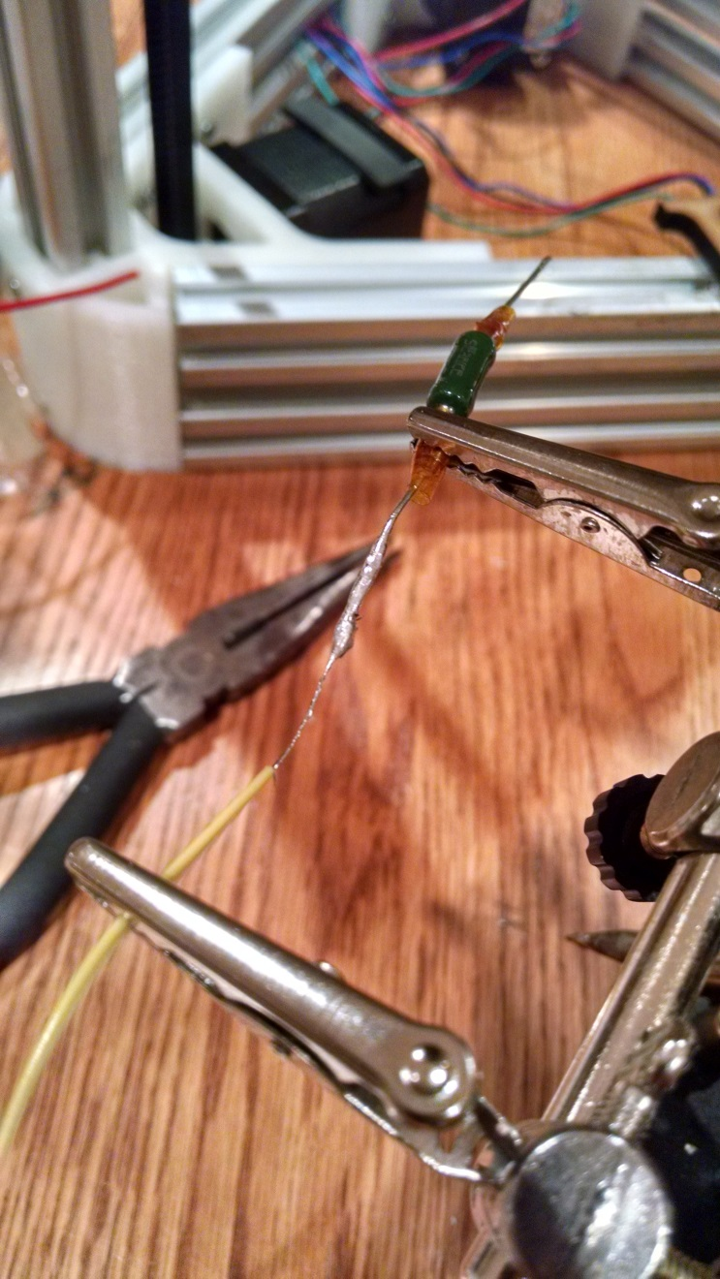
Skills in Hardware
Course of References:
● Electric Circuits (TECH 101) - Embedded Systems
● Hardware Production Technology
Skills:
● Measuring Voltages and Resistance
● Working with Stepper Motors
● Soldering and Wiring

Slide 5
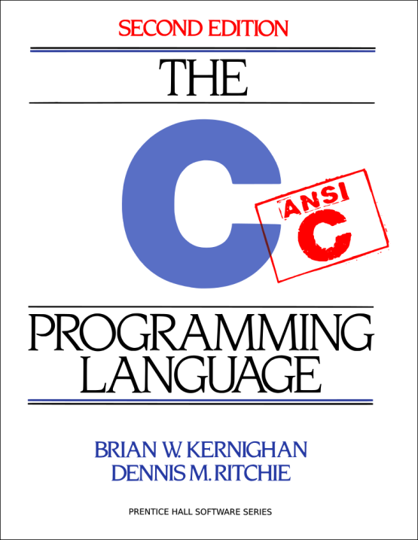


Skills in Software
Course of References:
● Technical C
● Programming Techniques in Java
● Internet Programming
Skills:
● Solid Foundation in Programming and Algorithm Development
● Learn How to Learn (API’s)
● Programming for Network Communication

Slide 6

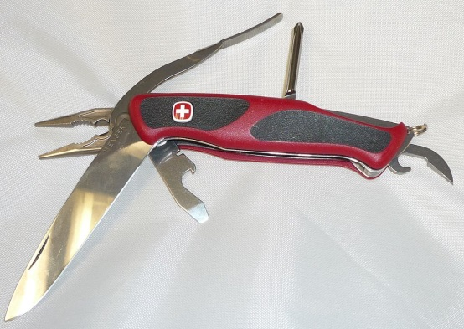

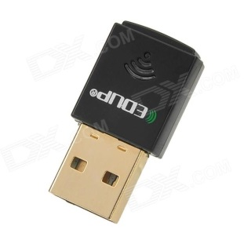
Skills in Networking
Course of References:
● Network Programming
● Networking Technologies
● Network Administration
Skills:
● Creating Client/Server Solutions
● Addressing, Protocols, Subnets, etc.
● Troubleshooting with Networking Tools

Slide 7
Planning and Schedule
App UI design
Joystick controller implemented
Socket server implemented
Signals sent to server
Subnet issue between Phone and Server

Slide 8
Reference Courses
CENG512 – Experience
CENG509 – Socket Server Programming
CENG300 – Android Development
CENG302 – System Analysis
CENG510 – Java Algorithms

Slide 9
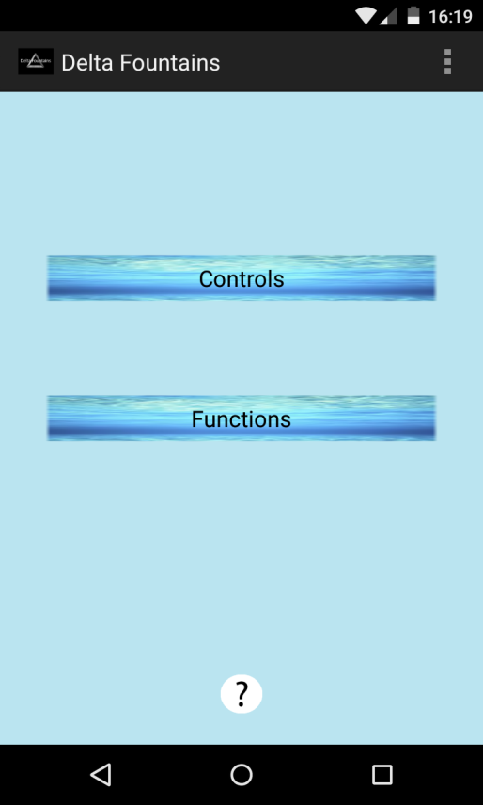
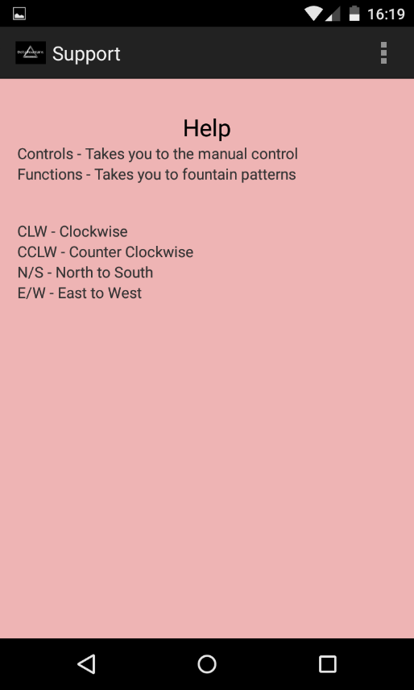
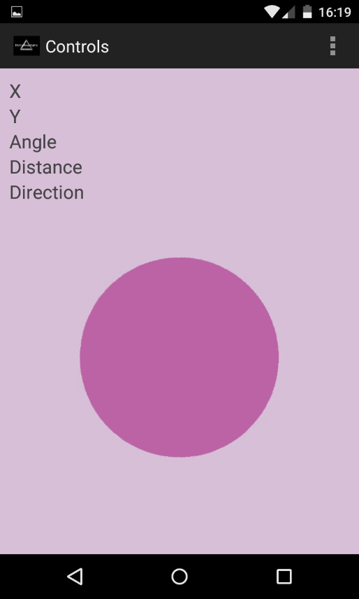
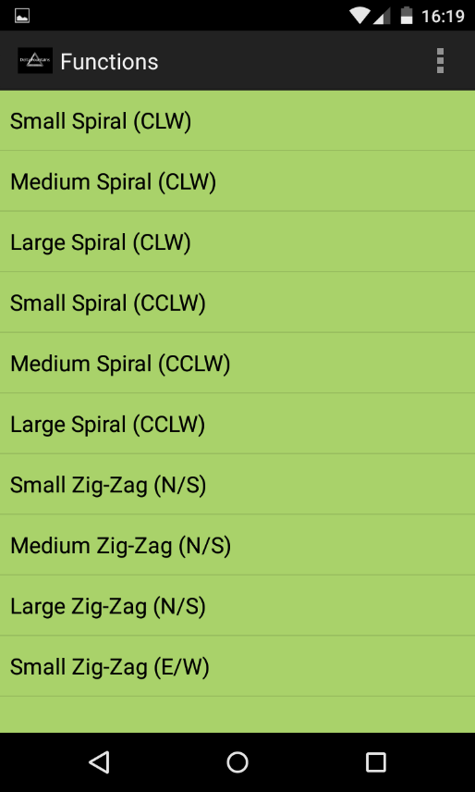
Main Screen
Help Screen
Keywords
Activities Description
Clicking on the Controls or Functions button will connect the app to the server
Controls is a joystick that sends a bearing to the server
Functions is a list of premade patterns for the fountain

Slide 10
Project Delta

